Slide 1
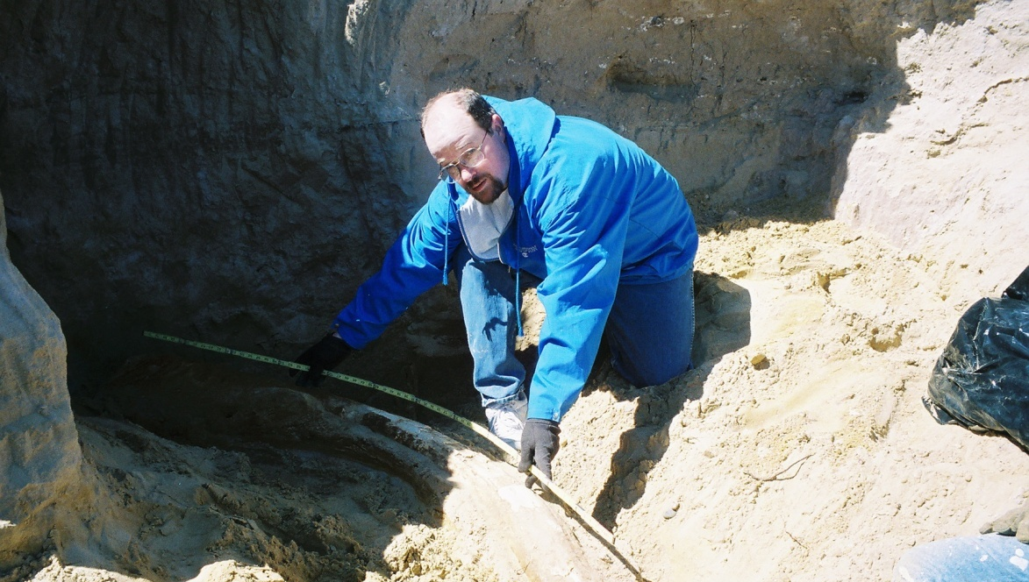
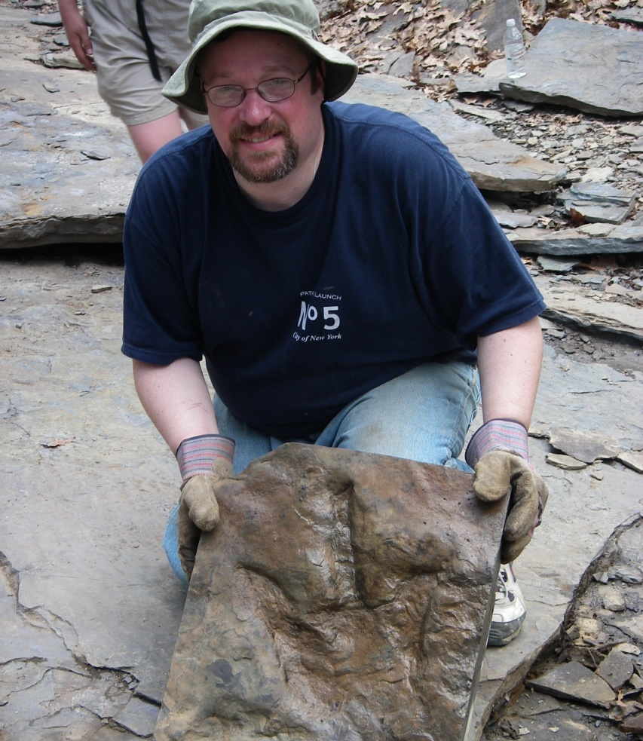
Rev. Paul Veit
www.EvangelisticEvents.com
Aka The “DinoPastor”

Slide 2
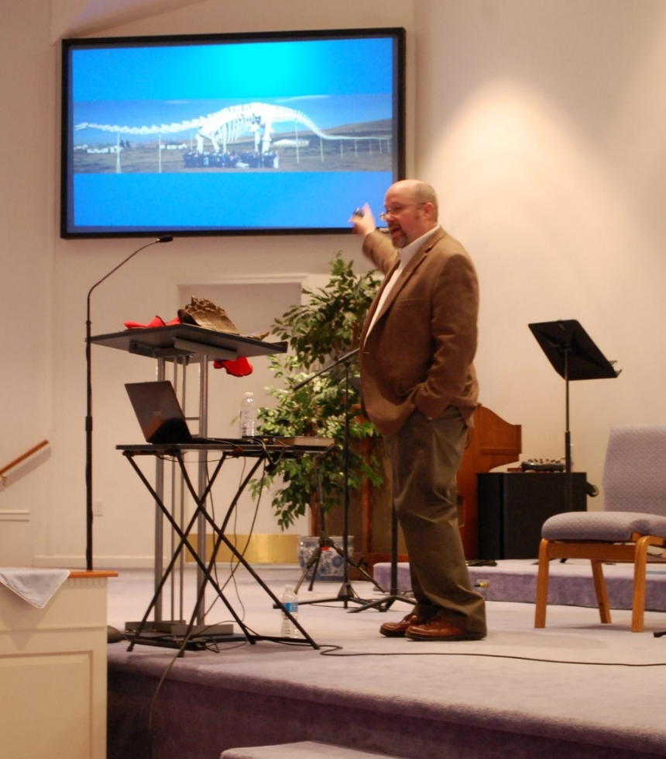
Creation and Apologetics
Evangelistic Events
1300+ outreaches

Slide 3
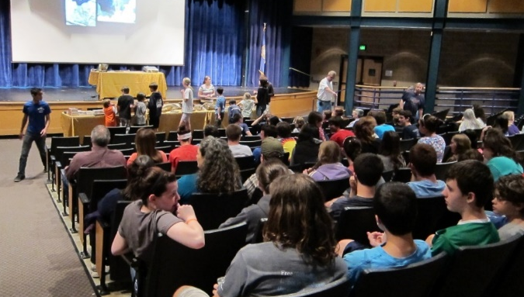
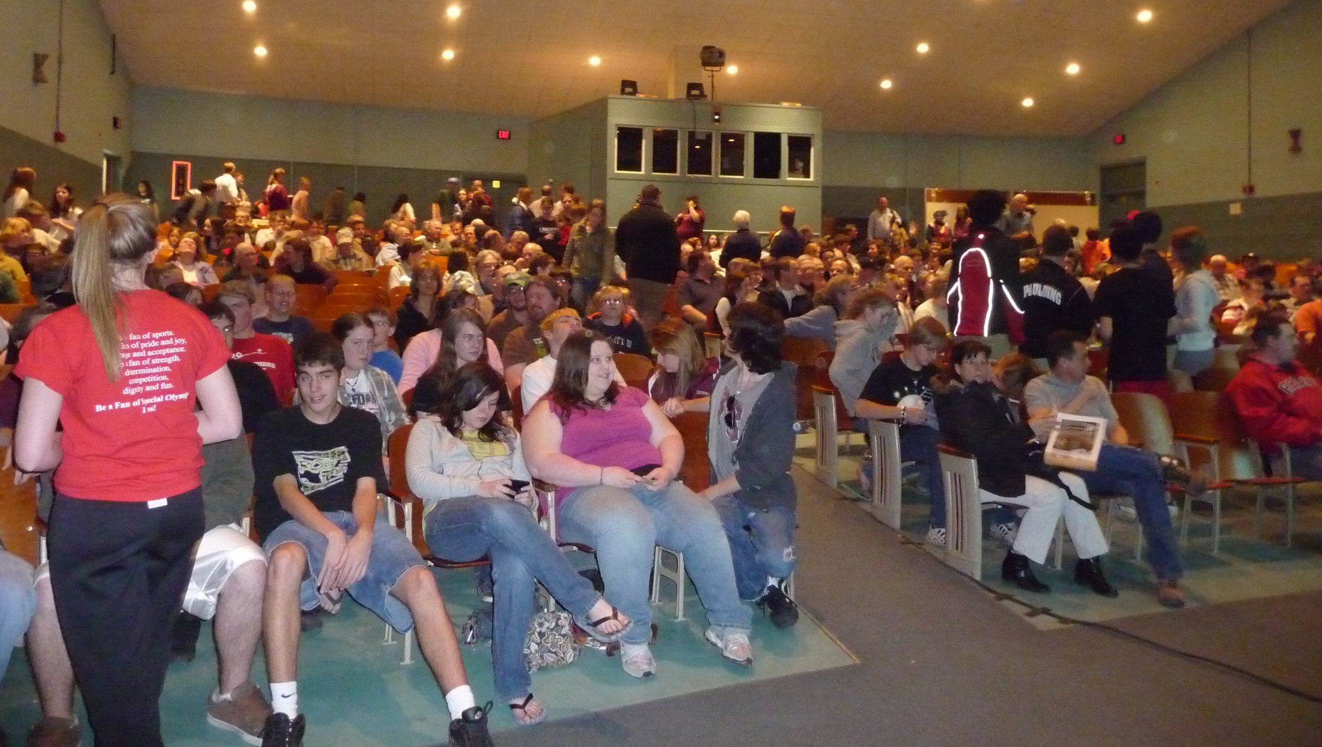
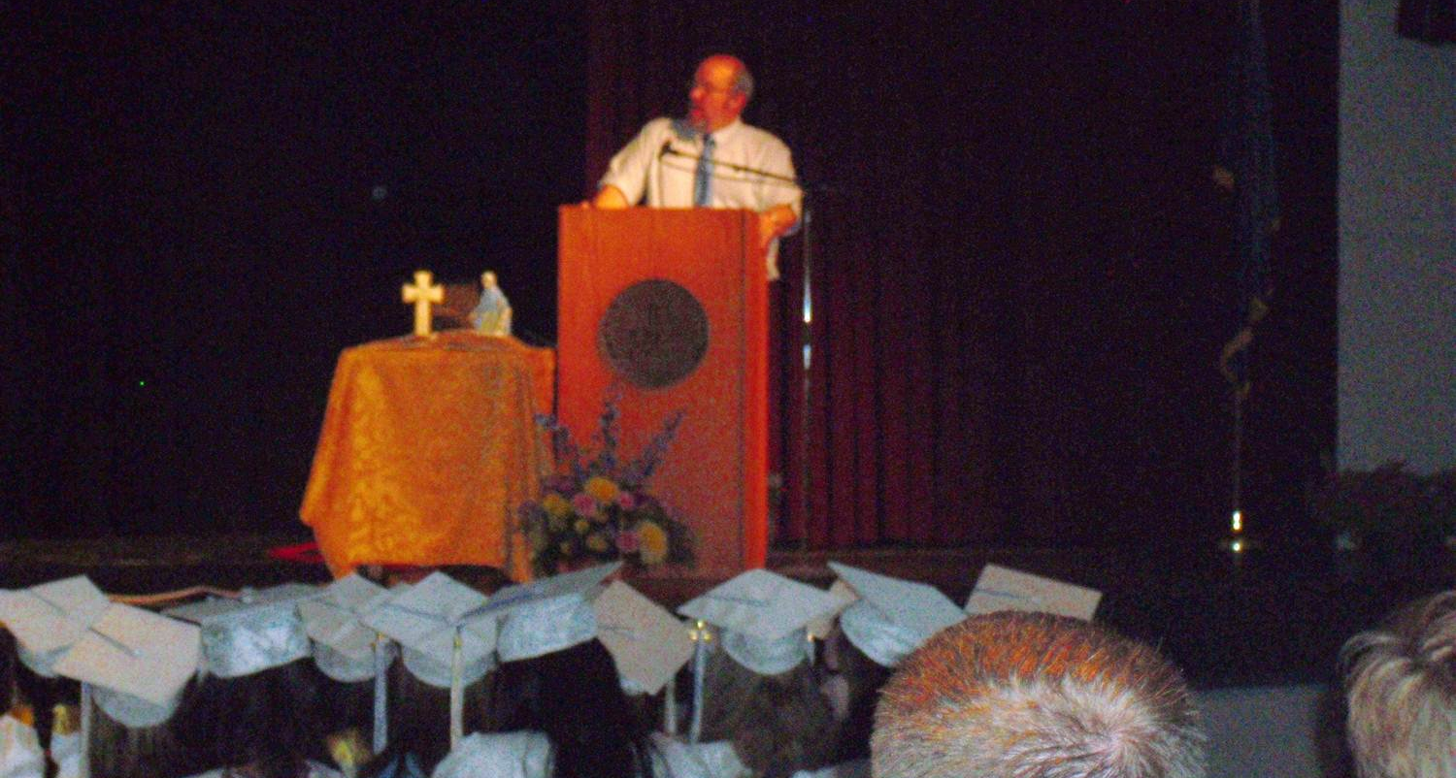
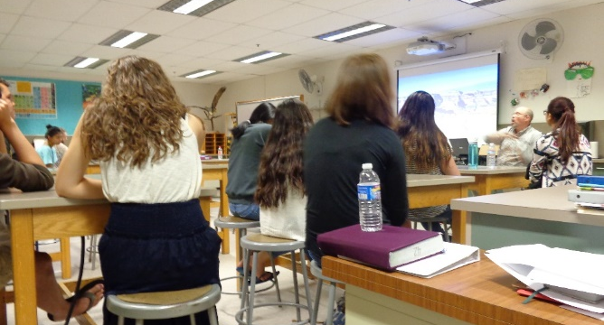
Paul speaks at…
Colleges
High Schools

Slide 4
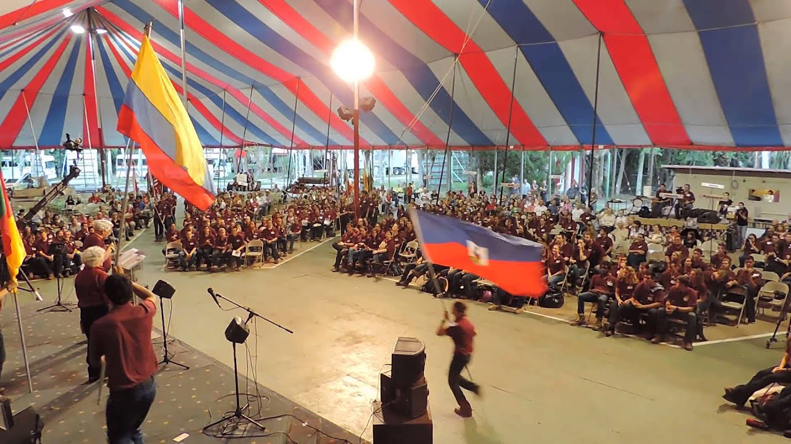
Teen Missions Boot Camp
Teen Missions
Boot Camp

Slide 5
Paul does
apologetics training
Youth With a Mission

Slide 6
Outreach Tours
22 Outreaches in 14 Days

Slide 7
Keynotes at Many conferences

Slide 8
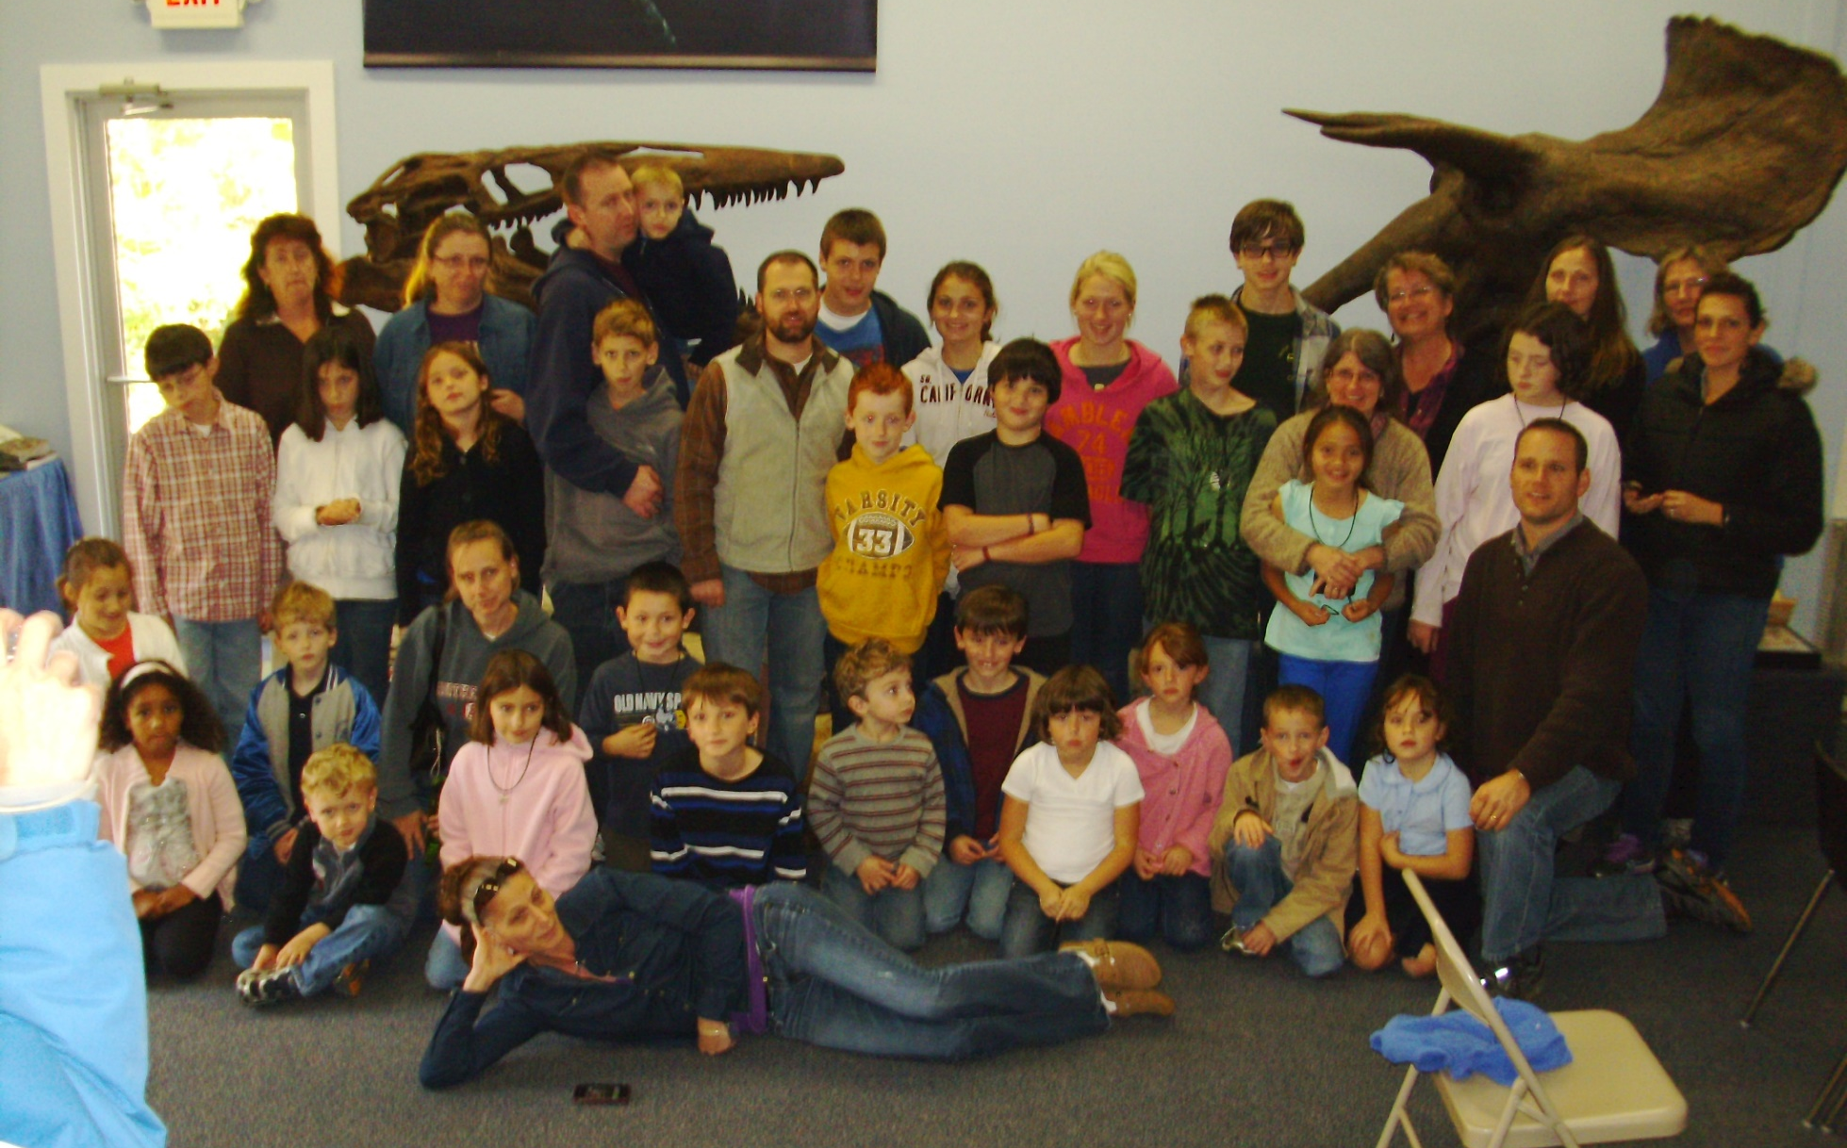
Dinosaur Encounter Bridgton, ME.

Slide 9
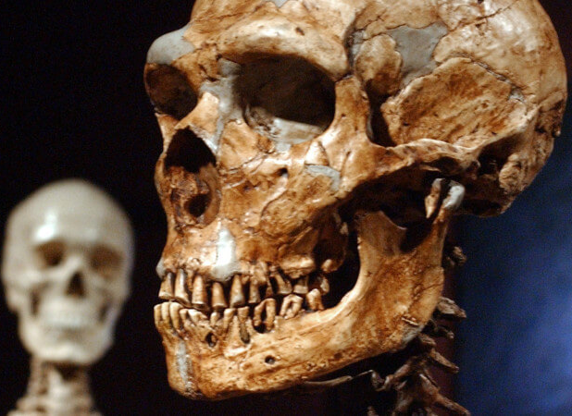
Creation vs.
Evolution:
Humans

Slide 10
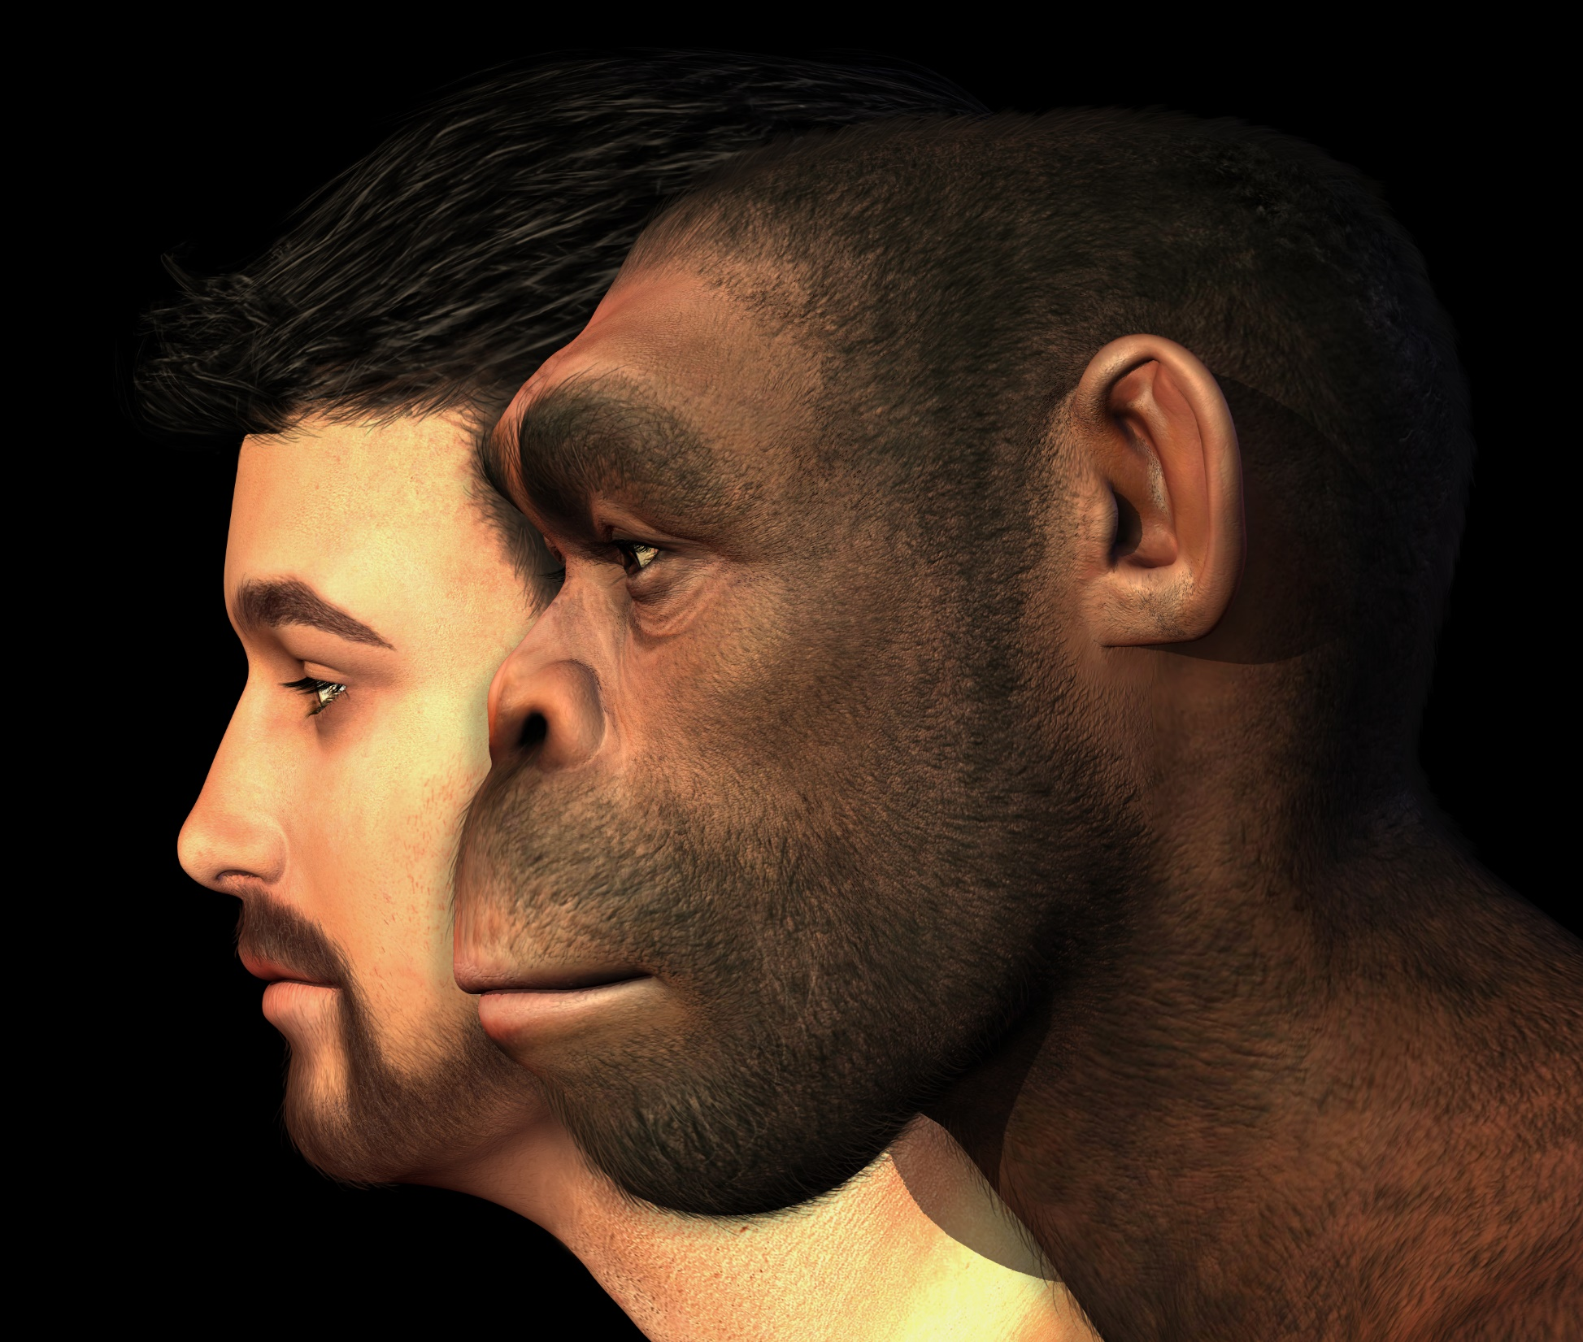
Deliberate
Deceptions
Presentation by:
Paul Veit
Declare God’s Wonders

Slide 11
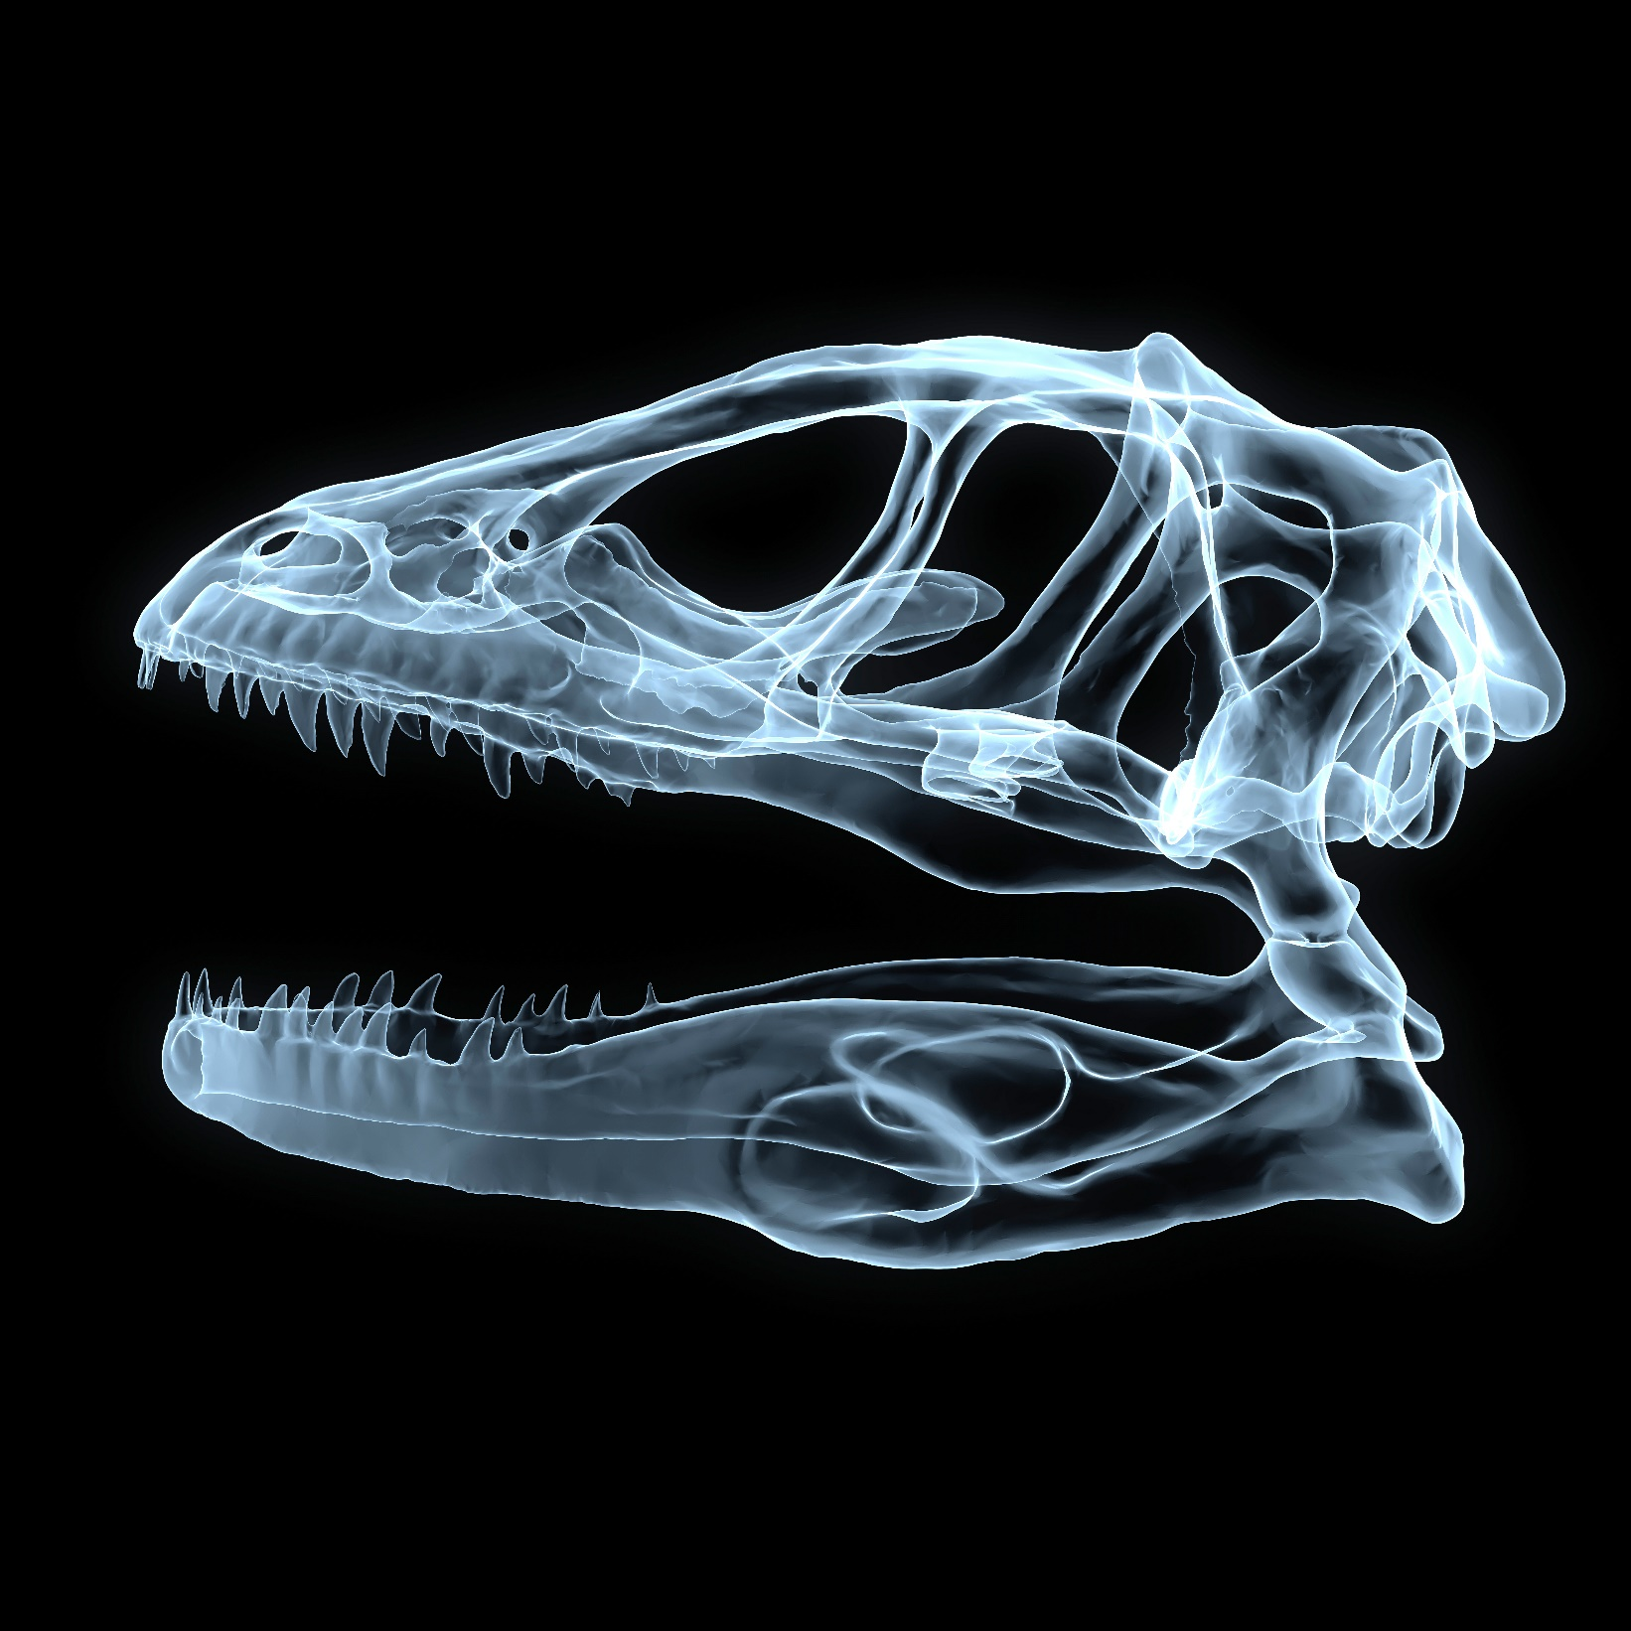
Creation vs.
Evolution
Dinosaurs

Slide 12
Aliens:
The truth

